Slide 1

-Entelect
By DiGital BlackSmiths

Slide 2
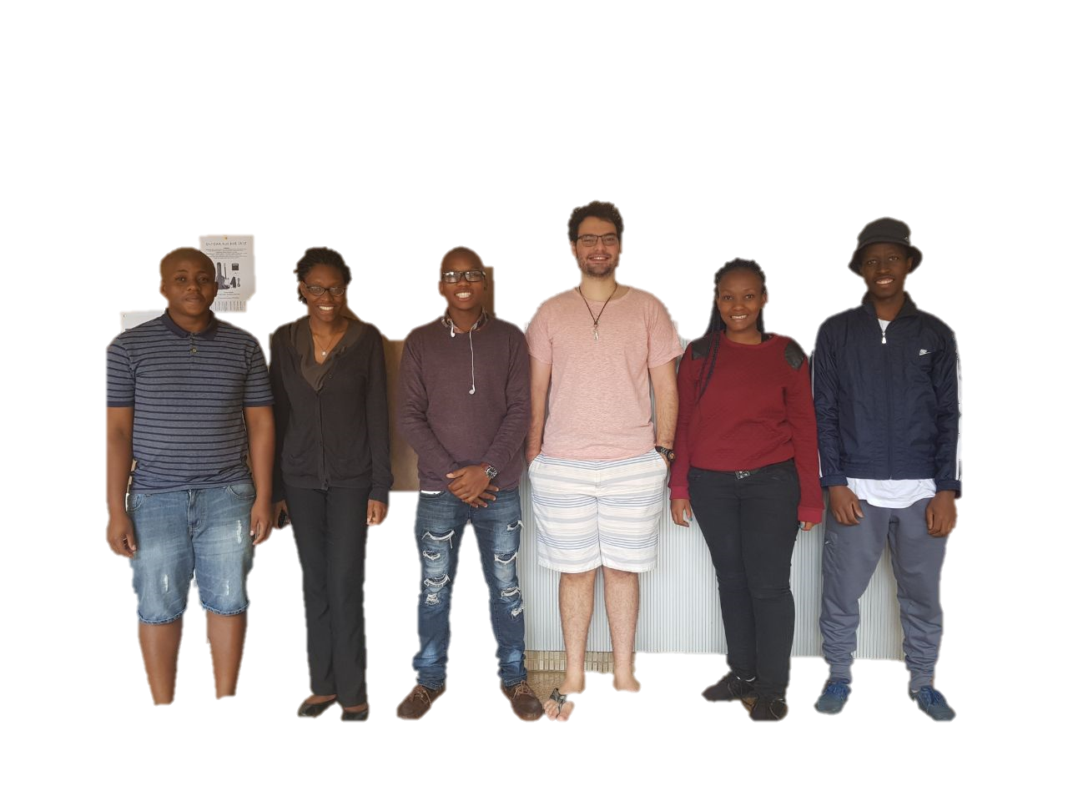
DiGital BlackSmiths
Team Member | Tlou Lebelo | Oluwatosin Botti | Fiwa Lekhuleni | Daniel Rocha | Lebogang Ntlatleng | Lesego Mabe
Role | Backend webserver and controller BSc CS | Front-end and UI BSc IT | Group Leader Backend webserver and controller BSc CS | Front-end and UI BSc IT | Database and Content Manangement BSc CS | Database and Content Manangement BSc CS

Slide 3
Thutong Learning Centre
PROJECT DESCRIPTION
Create a mobile friendly site.
Employ ease of use + maintain learning system for all learners.
Must follow SA School Curriculum in order to improve learners' subject results:
Mathematics
Science
Other subjects
Enhance learner ICT skills, by:
Providing a free and accessible educational learning platform online.

Slide 4
Code quality
Clarity: Code is clear, consistency, managable.
Maintainable: Low coupling and high cohesion -> modularised:
Update
Maintain functionally
Documented: Uses a common structured format:
Display comments, functions and sections
labelled by comments or descriptive folder names for member modules.

Slide 5
Code quality
Refactored: Code formatting needs to be consistent and follow the language’s coding conventions.
Well-tested: Testing filters out critical bugs.
Done for all major use cases
Allow for an easier level of use.
Extensible: The code allows for:
Limit code repetitions
Code re-use.
Efficiency: High-quality code:
Code re-use
Import.

Slide 6
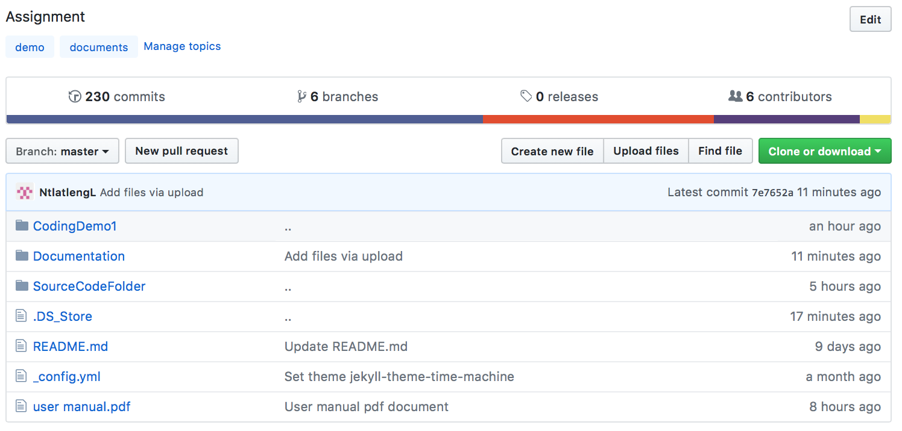
Github screenshots

Slide 7
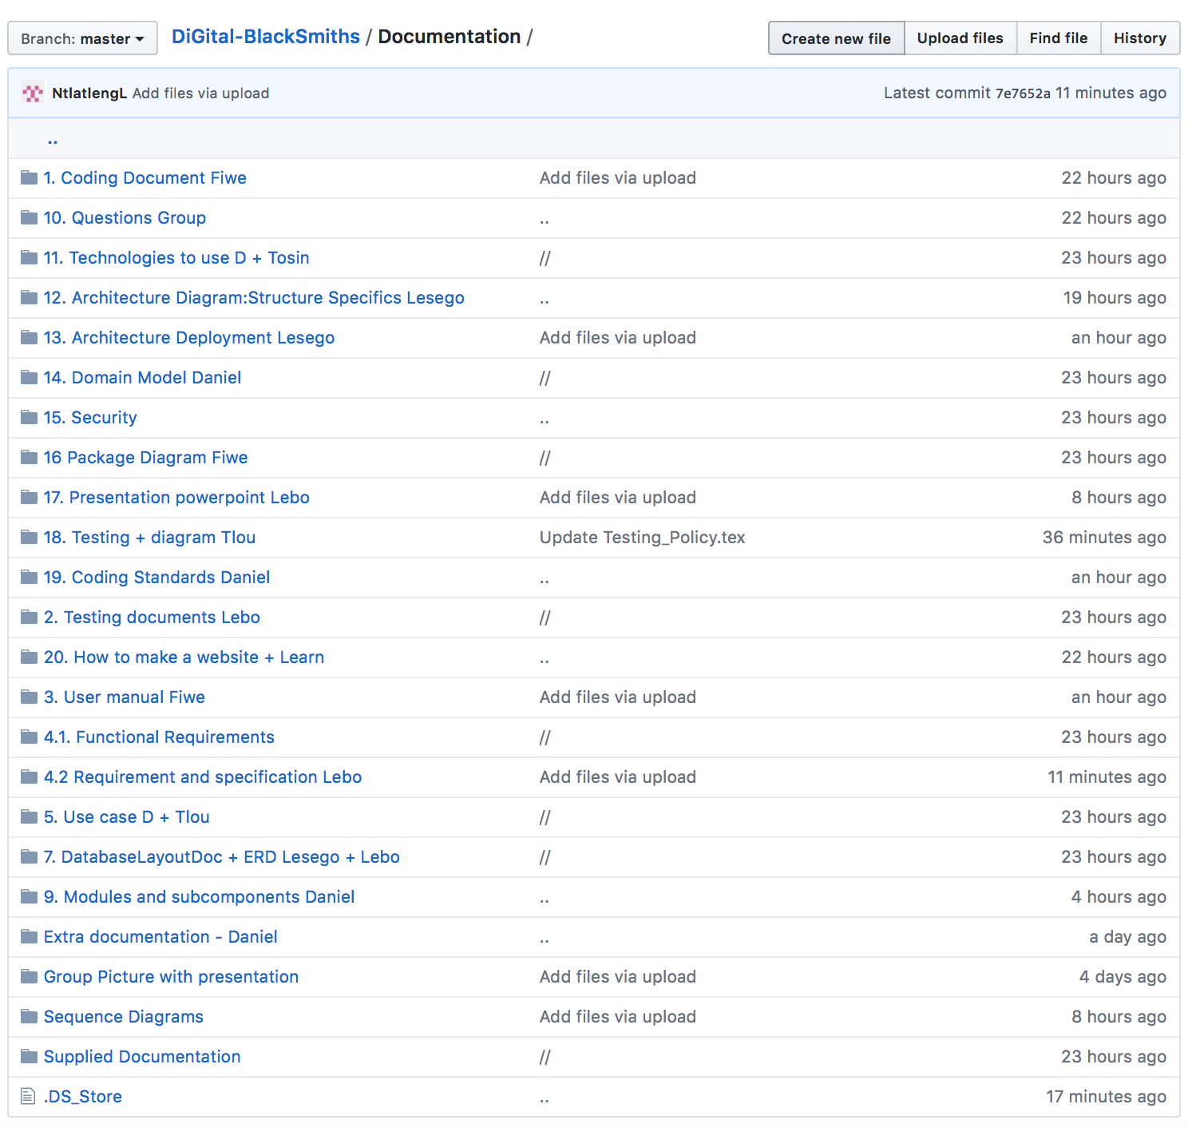
Github Files

Slide 8
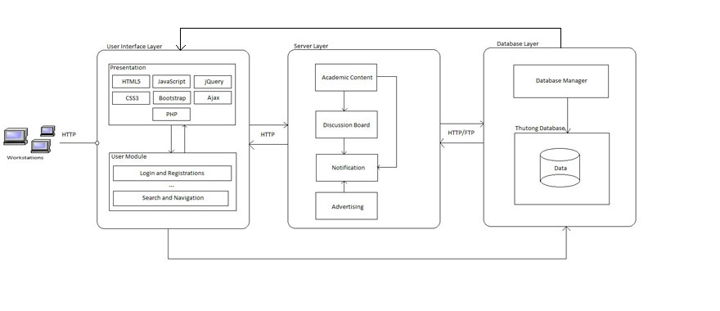
Deployment Diagram

Slide 9
Technologies Used
^{TECHNOLOGIES TO USE}
1. Html + bootstrap (display UI)
^{2. Javascript + Ajax}
3. Php (interact with database)
^{4. Ftp (upload document)}
5. Phpmyadmin + xamp (database software)
6. Mysqli (connect to the database)
^{7. Sql (database type)}
8. Ajax + google Addsense (adverts/show)
^{9. HTTPS - secutity}
10. Css and Bootstrap (Cross browser support, adds to modularity) 11. jQuery
-> Designed with low coupling, high cohesion.

Slide 10
Module Structure
^{MODULES for SYSTEM}
Academic Content
Advertising
DiscussionBoard
Notifications
SearchAndNavigation
UserProfiles
Presentation

